Slide 1
Course Prerequisite
Prepared by: SO Vengleab
Date: Jul - 2026

Slide 2
Prerequisite
Python 3.12+
Anaconda & JupyterLab
IDE Installed ( Antigravity, Visual Studio Code, Cursor, Windsurf etc)

Slide 3
Install Python

Slide 4
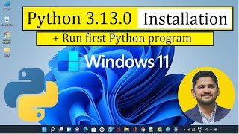
Installing Python

Slide 5
Install Anaconda

Slide 6

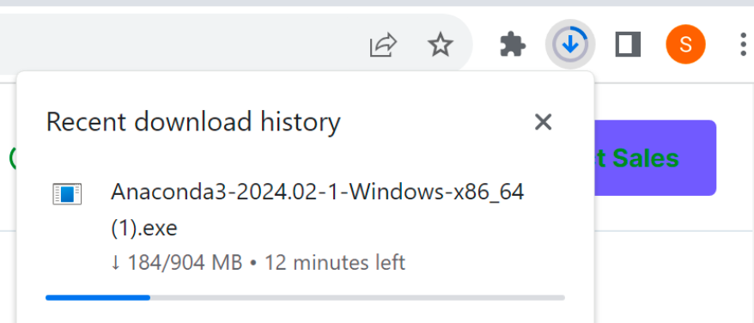
Download Anaconda
INSTALLATION — STEP 1 OF 4
One installer: Python + Jupyter.
Go to anaconda.com/download and press the Download button.
The installer appears in your browser's download history (top-right corner) — about 900 MB, so give it a few minutes.
Notes:
Source pages 5–7.

Slide 7
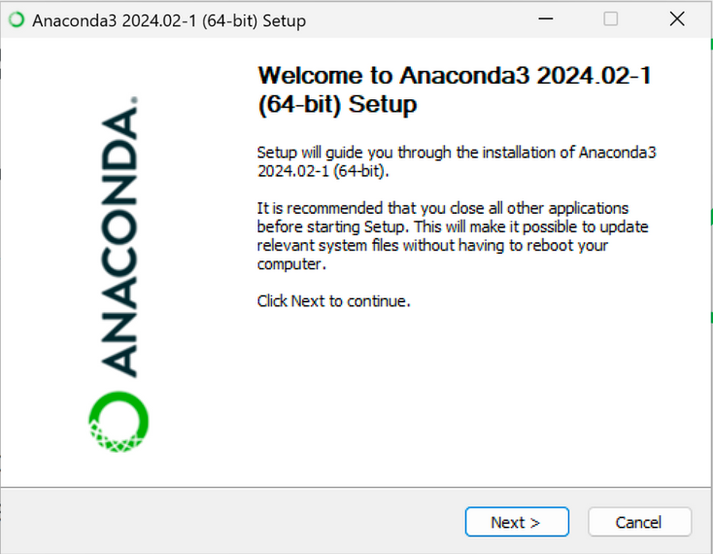
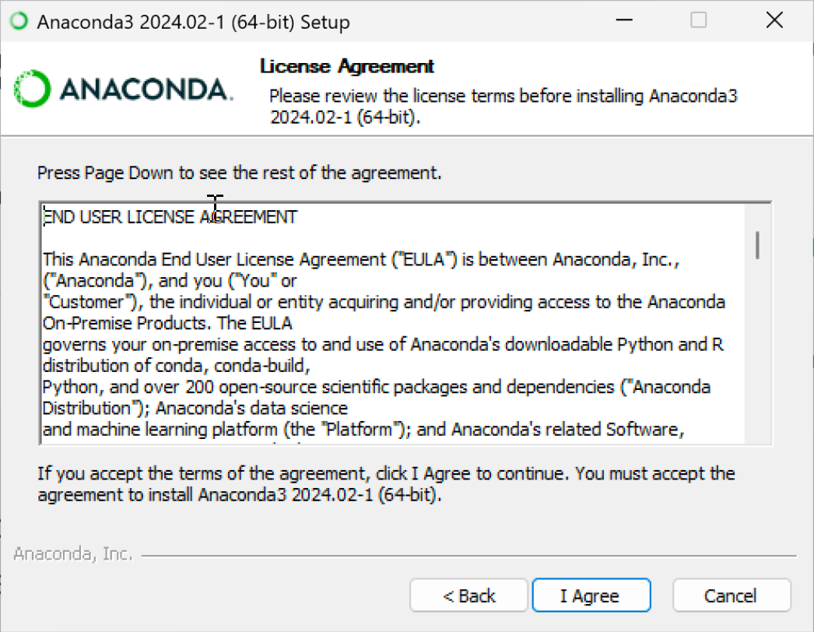
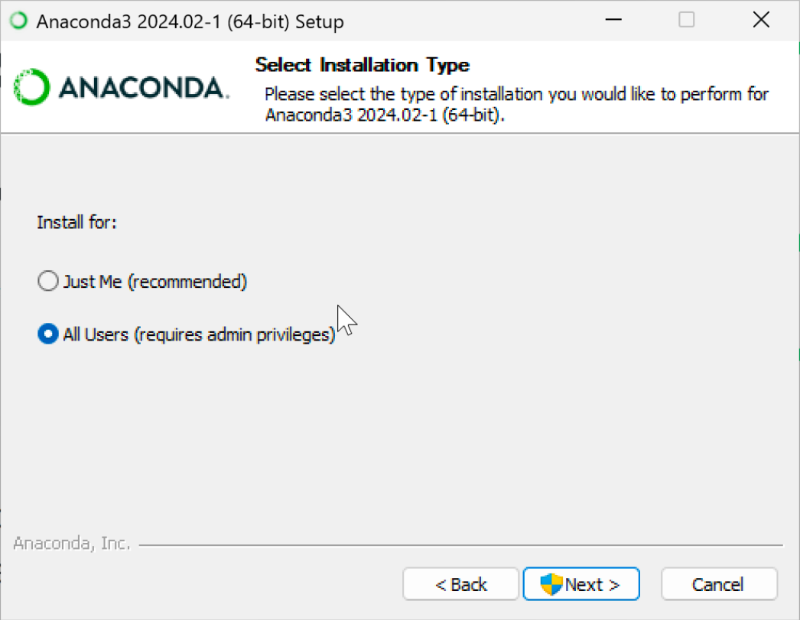
Run the Setup Wizard
INSTALLATION — STEP 2 OF 4
Next → I Agree → choose users.
Open the downloaded .exe and click Next on the welcome screen.
Click I Agree on the license, then pick All Users or Just Me and allow the app with Yes.
Notes:
Source pages 8–11.

Slide 8
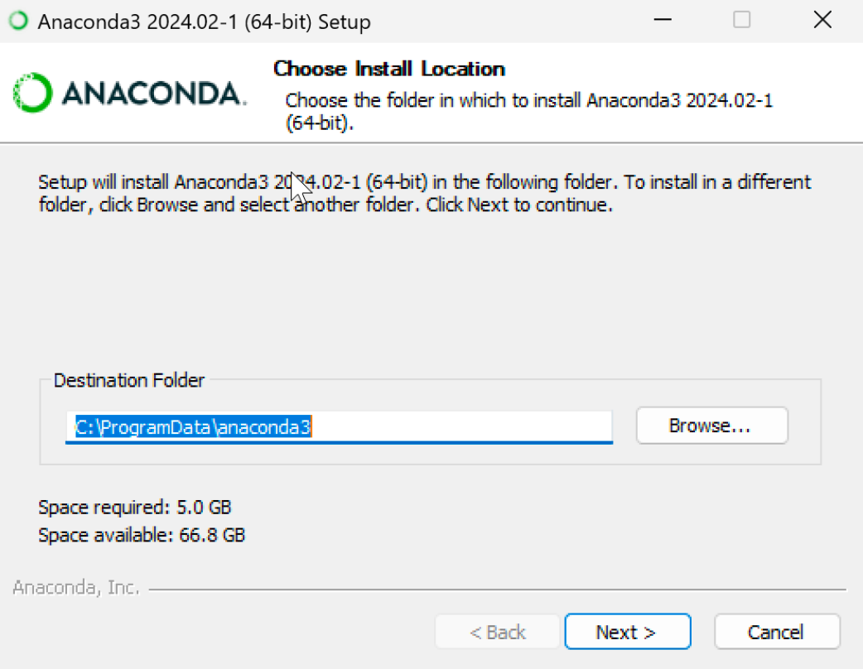
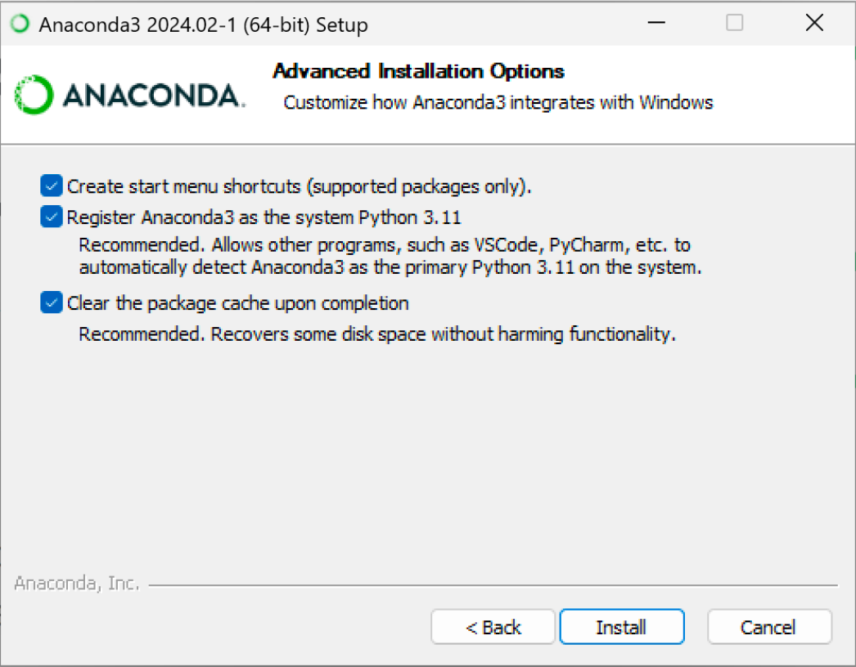
Location and Options
INSTALLATION — STEP 3 OF 4
Keep the defaults.
Browse to a destination folder or keep the default (needs ~5 GB), then click Next.
Select all options on Advanced Installation — registering Anaconda as system Python lets VS Code and PyCharm auto-detect it — then Install.
Notes:
Source pages 12–13.

Slide 9
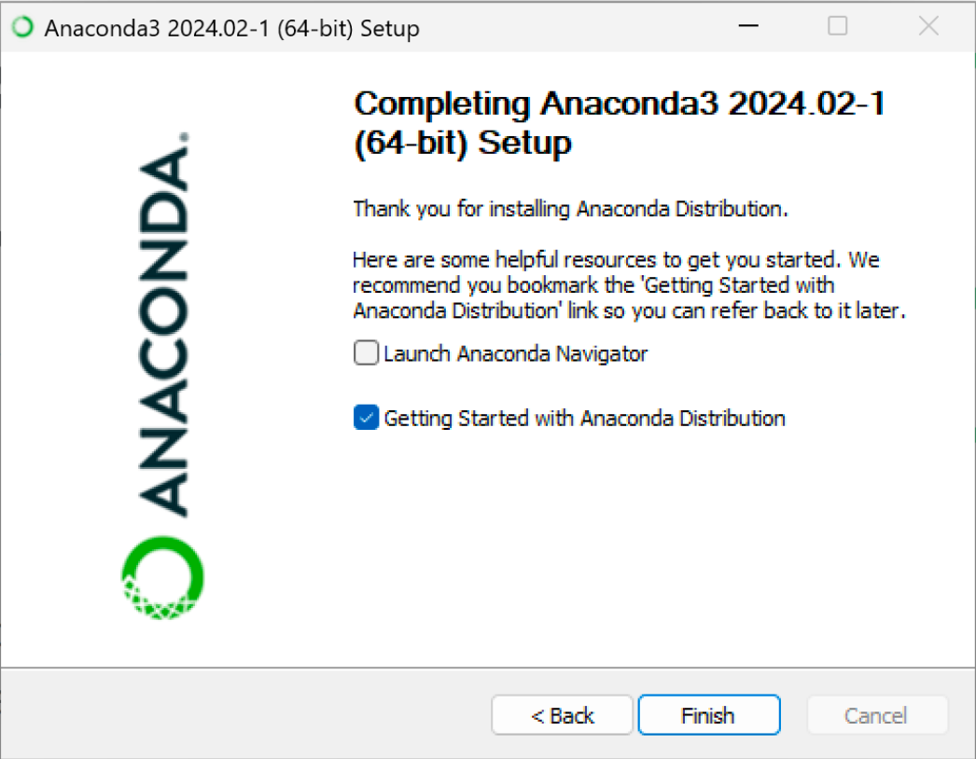
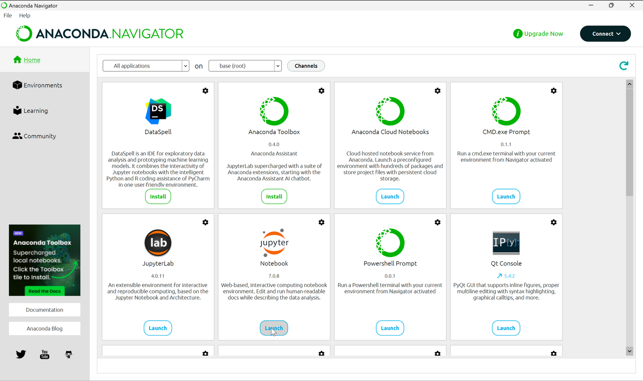
Finish and Launch
INSTALLATION — STEP 4 OF 4
Untick the extras.
Click Next → Finish; you can untick all selections on the last screen.
Find Anaconda Navigator in the Start menu and press Launch on the Jupyter Notebook tile (or open Jupyter Notebook directly).
Notes:
Source pages 14–18. Browser choice (page 19): pick Chrome + Always.

Slide 10
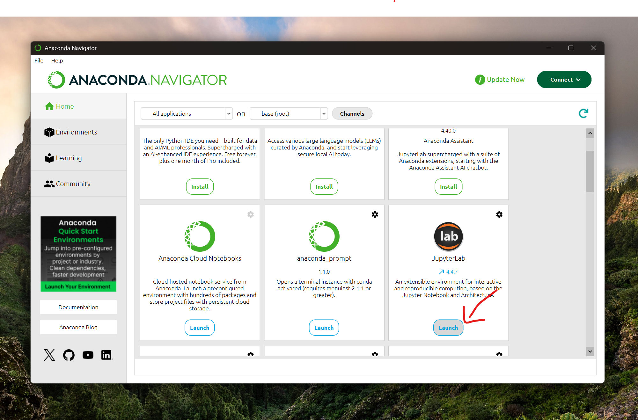
Open Anaconda

